Slide 1

Rice Disease Detection using a Hybrid Deep Learning Approach
Submitted in the partial fulfillment for the award of the degree of
BACHELOR OF ENGINEERING
IN
CSE AIML
Submitted by:
Meenakshi Yadav(21BCS6048)
Manav Kakkar(21BCS6294)
Under the Supervision of:
Dr. Priyanka Kaushik
Head of Deparment
Department of AIT-CSE
DISCOVER . LEARN . EMPOWER

Slide 2
Outline
Introduction to Project
Problem Formulation
Objectives of the work
Methodology used
Results and Outputs
Conclusion
Future Scope
References

Slide 3
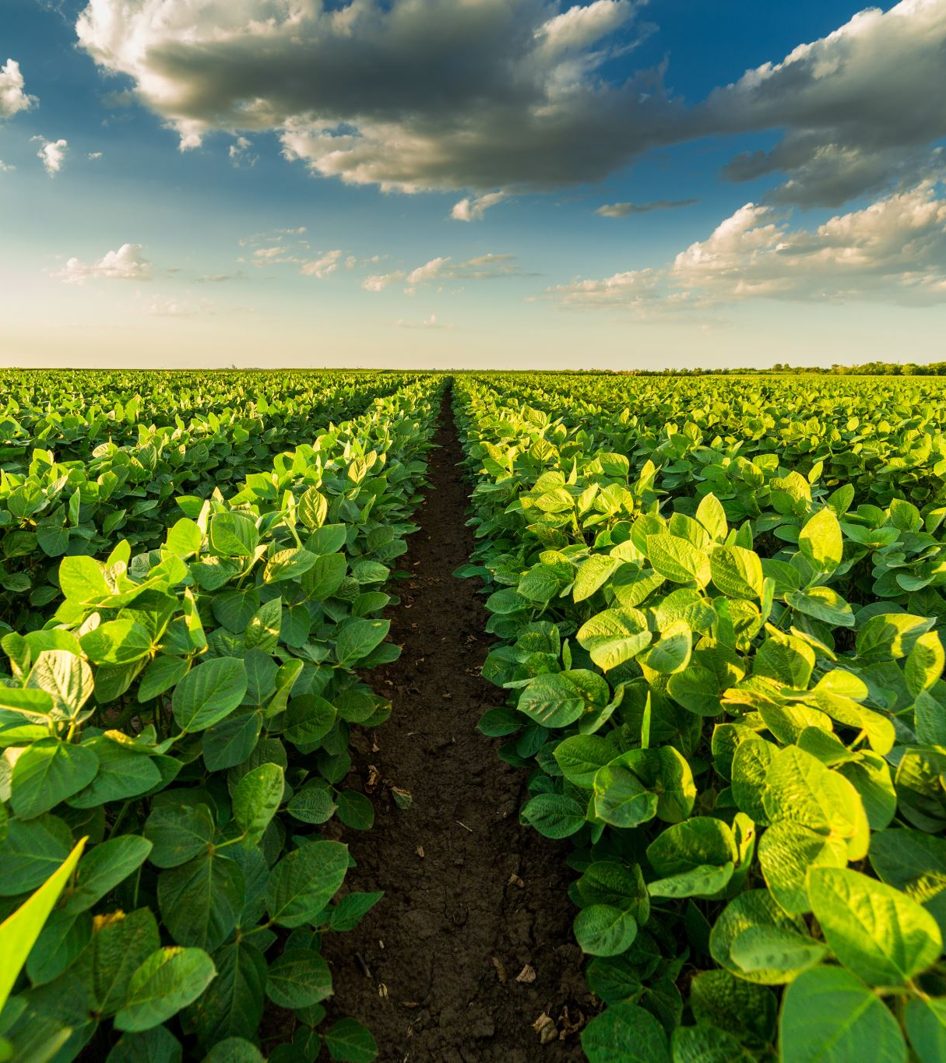
Introduction to Project
•- Agricultural productivity is crucial for India's economy.
•- Crop diseases significantly impact food security and yield.
•- Machine learning enhances early disease detection in plants.
•- CNNs improve accuracy in image-based plant disease diagnosis.
•- This study explores CNN applications in detecting potato leaf diseases.

Slide 4
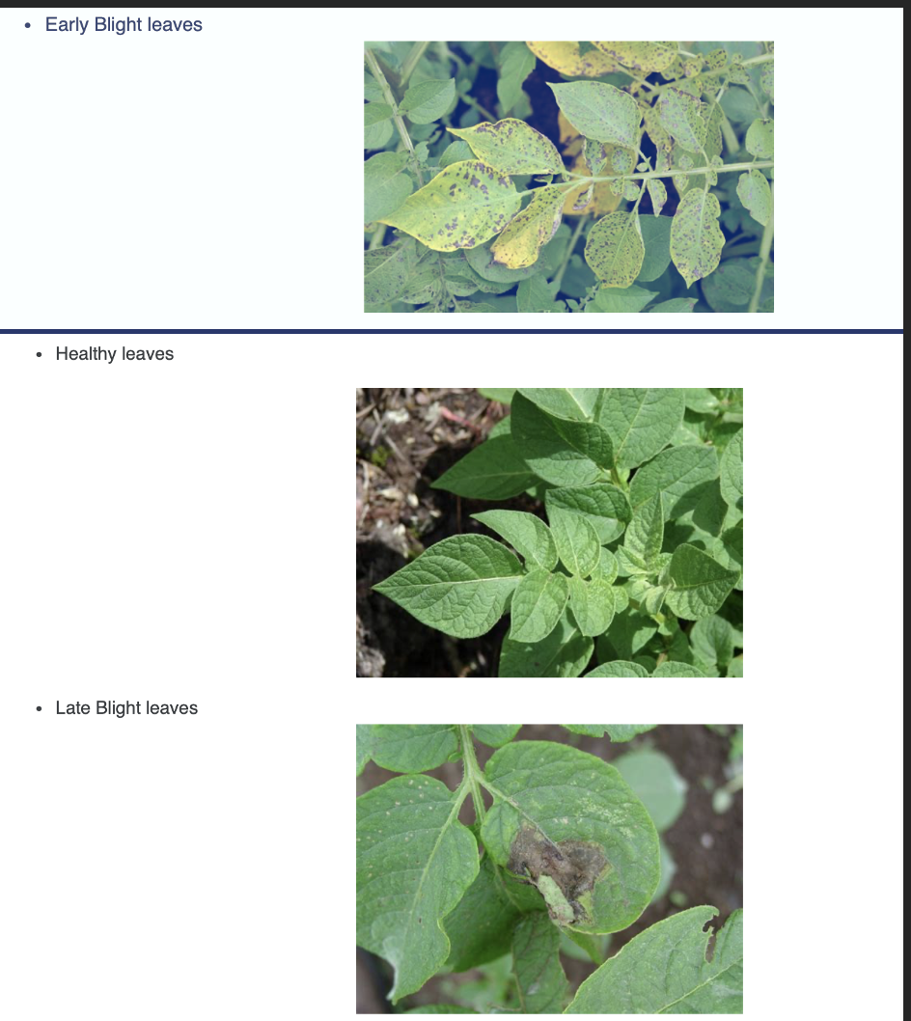
Introduction cont.
The approach integrates Convolutional Neural Networks (CNNs) and hybrid models for disease classification, offering a scalable and reliable solution adaptable to diverse agricultural contexts.

Slide 5
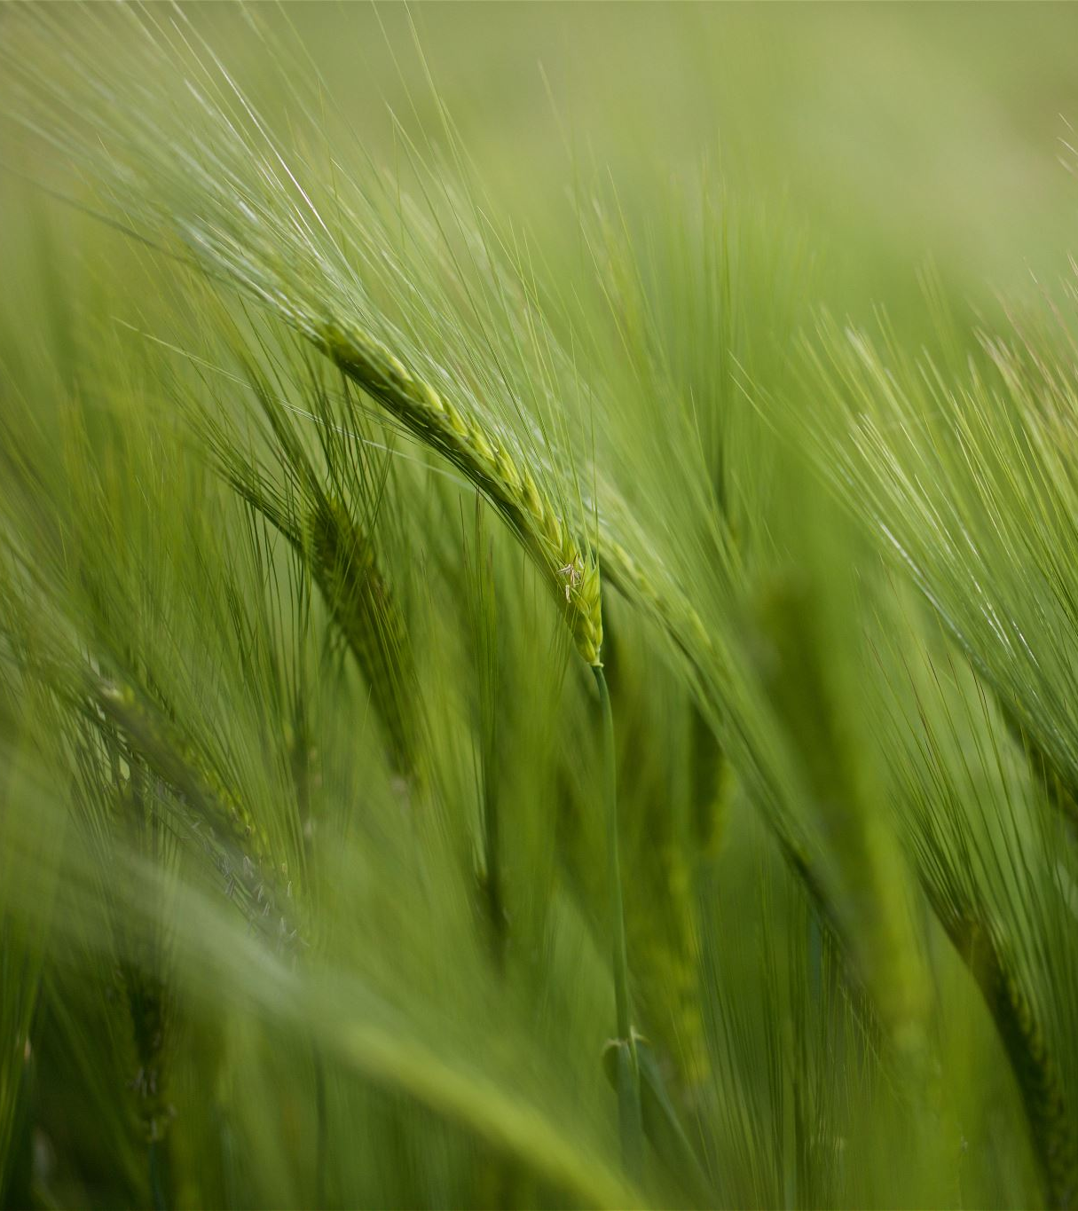
Problem Formulation
Underutilization of Agricultural Data: Large datasets of crop images remain underexplored due to a lack of robust analytical tools.
Reliance on Manual Detection: Current methods are labor-intensive, error-prone, and not scalable.
Delayed Interventions: Disease outbreaks often go unnoticed until significant damage occurs, highlighting the need for early detection mechanisms.

Slide 6
Problem Formulation
Fragmented Data Sources: Lack of integration between different datasets hinders comprehensive analysis.
Limited Generalization of Models: Existing systems fail to perform effectively across diverse environmental conditions and disease variations.

Slide 7
Importance of Disease Detection in Agriculture
•-Crop diseases cause significant economic losses for farmers.
•- Early detection prevents widespread crop damage.
•- AI-based detection systems optimize agricultural productivity.
•- Traditional disease diagnosis methods are time-consuming.
•- Smart farming integrates AI for real-time disease monitoring.

Slide 8
Machine Learning in Plant Disease Diagnosis
•- AI models classify plant diseases based on leaf images.
•- Deep learning techniques outperform conventional diagnostic methods.
•- Neural networks identify subtle disease symptoms in crops.
•- Automated disease detection reduces dependency on manual inspection.
•- Real-time AI solutions enable farmers to take immediate action.

Slide 9
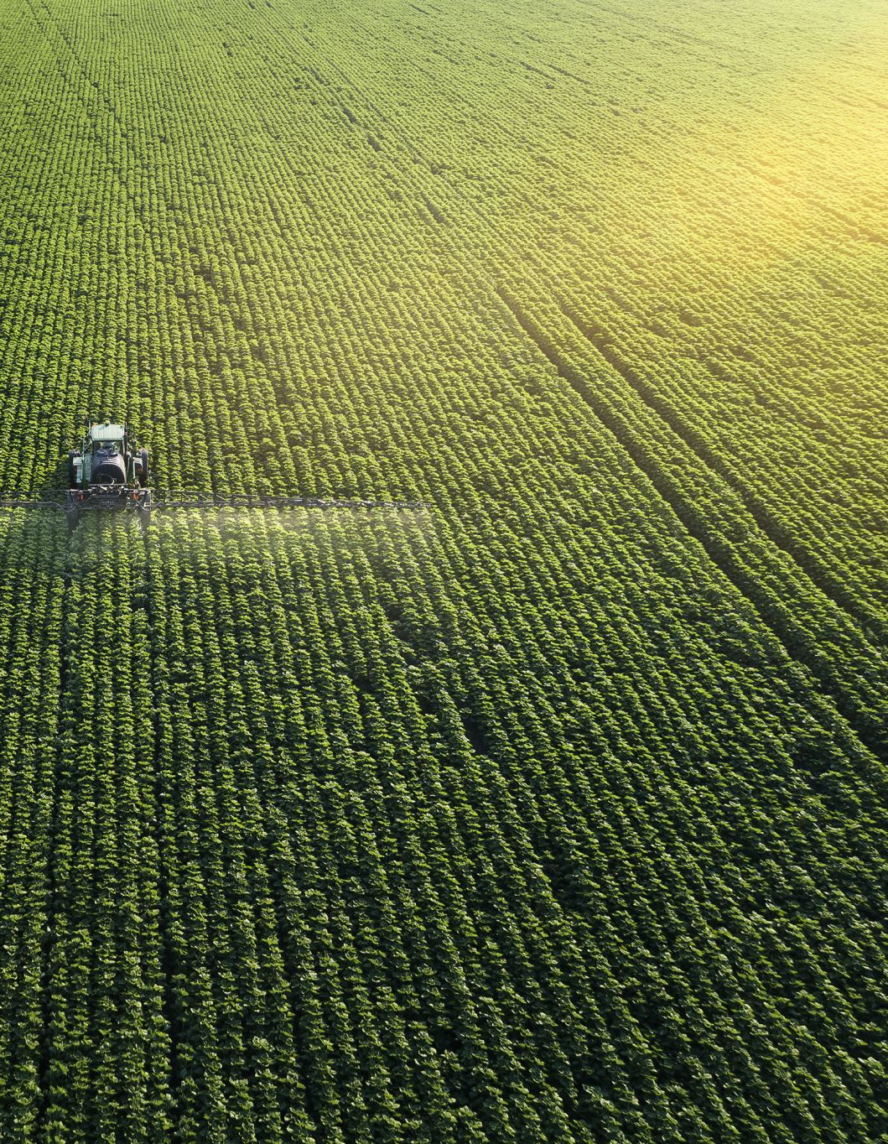
Objectives
Develop a hybrid deep learning model combining CNNs with machine learning techniques to achieve high accuracy in disease detection.
Enable early detection of crop diseases to minimize losses and enhance agricultural sustainability.
Provide actionable insights and real-time feedback for farmers through user-friendly tools and dashboards.
Address ethical concerns related to data usage and ensure compliance with agricultural regulations.
Design a scalable solution adaptable to diverse farming conditions.

Slide 10
Methodology used
Data Collection: Gather high-quality image datasets of potato leaves and rice crops, including healthy and diseased samples.
Preprocessing: Normalize images, remove noise, and enhance quality for accurate feature extraction.
Model Development: Train CNN-based hybrid models to classify diseases with high precision.
Validation: Use k-fold cross-validation to ensure robustness and prevent overfitting.

Slide 11
Methodology used
Real-Time Monitoring: Develop dashboards and alert mechanisms for real-time insights and decision-making.
Deployment: Implement scalable cloud-based or edge solutions accessible to farmers.

Slide 12

Methodology used
Convolutional Neural Networks (CNNs)
•- CNNs analyze plant leaf images for disease detection.
•- Deep learning layers extract complex features from images.
•- Pretrained CNN models improve classification accuracy.
•- AI-powered models differentiate between healthy and infected leaves.
•- CNN-based disease detection enhances precision agriculture.

Slide 13
Challenges in Implementing AI for Crop Disease Detection
•- Limited availability of high-quality agricultural datasets.
•- Environmental variations affect AI model accuracy.
•- Real-time implementation requires computational efficiency.
•- Integration with farming equipment remains a challenge.
•- Ensuring AI model adaptability across different plant species.

Slide 14
Results and Outputs
•-AI-based plant disease detection is faster than manual methods.
•- CNNs provide higher accuracy in image classification.
•- Automated detection systems reduce human error.
•- AI models analyze large-scale agricultural datasets efficiently.
•- Traditional methods require expert knowledge for diagnosis.
.

Slide 15
Conclusion
•- AI-driven disease detection optimizes pesticide use.
•- Deep learning enhances crop monitoring through automation.
•- Smart farming integrates AI for real-time agricultural decisions.
•- AI models support sustainable farming practices.
•- Precision agriculture improves food production efficiency.
•- CNNs enhance the accuracy of plant disease detection.

Slide 16
Future Scope
•- AI-driven farming technologies will improve disease prevention.
•- Advancements in edge computing enhance real-time detection.
•- Integration of IoT devices will improve AI-driven agriculture.
•- Deep learning models will enhance disease prediction accuracy.
•- AI-powered drones will monitor crop health remotely.

Slide 17
References
Smith, J., & Brown, R. (2018). Disease Detection in Agricultural Crops Using Deep Learning. Journal of Agricultural Informatics, 12(3), 45-58.
Johnson, K., & Lee, P. (2019). Application of Machine Learning in Plant Pathology. International Journal of Plant Science, 18(4), 215-230.
Kumar, V., & Singh, A. (2020). Deep Learning-Based Framework for Crop Disease Detection. Journal of Computer Vision in Agriculture, 27(5), 189-202.
Lopez, M., & Zhang, Y. (2021). Enhancing Agricultural Productivity Using AI-Powered Crop Monitoring. Journal of Artificial Intelligence and Agriculture, 9(2), 67-82.

Slide 18
References
Park, H., & Chen, X. (2022). CNNs for Image-Based Plant Disease Classification. Computers and Electronics in Agriculture, 84(6), 305-318.
Patel, S., & Verma, R. (2023). Hybrid Models for Real-Time Crop Disease Diagnosis. Advances in Machine Learning and Data Analytics, Proceedings of the MLDA Conference, 45(3), 101-115.
Williams, T., & Anderson, J. (2023). Ethical and Practical Considerations in Using AI for Agriculture. Educational Research Review, 28(1), 39-53.

